Slide 1
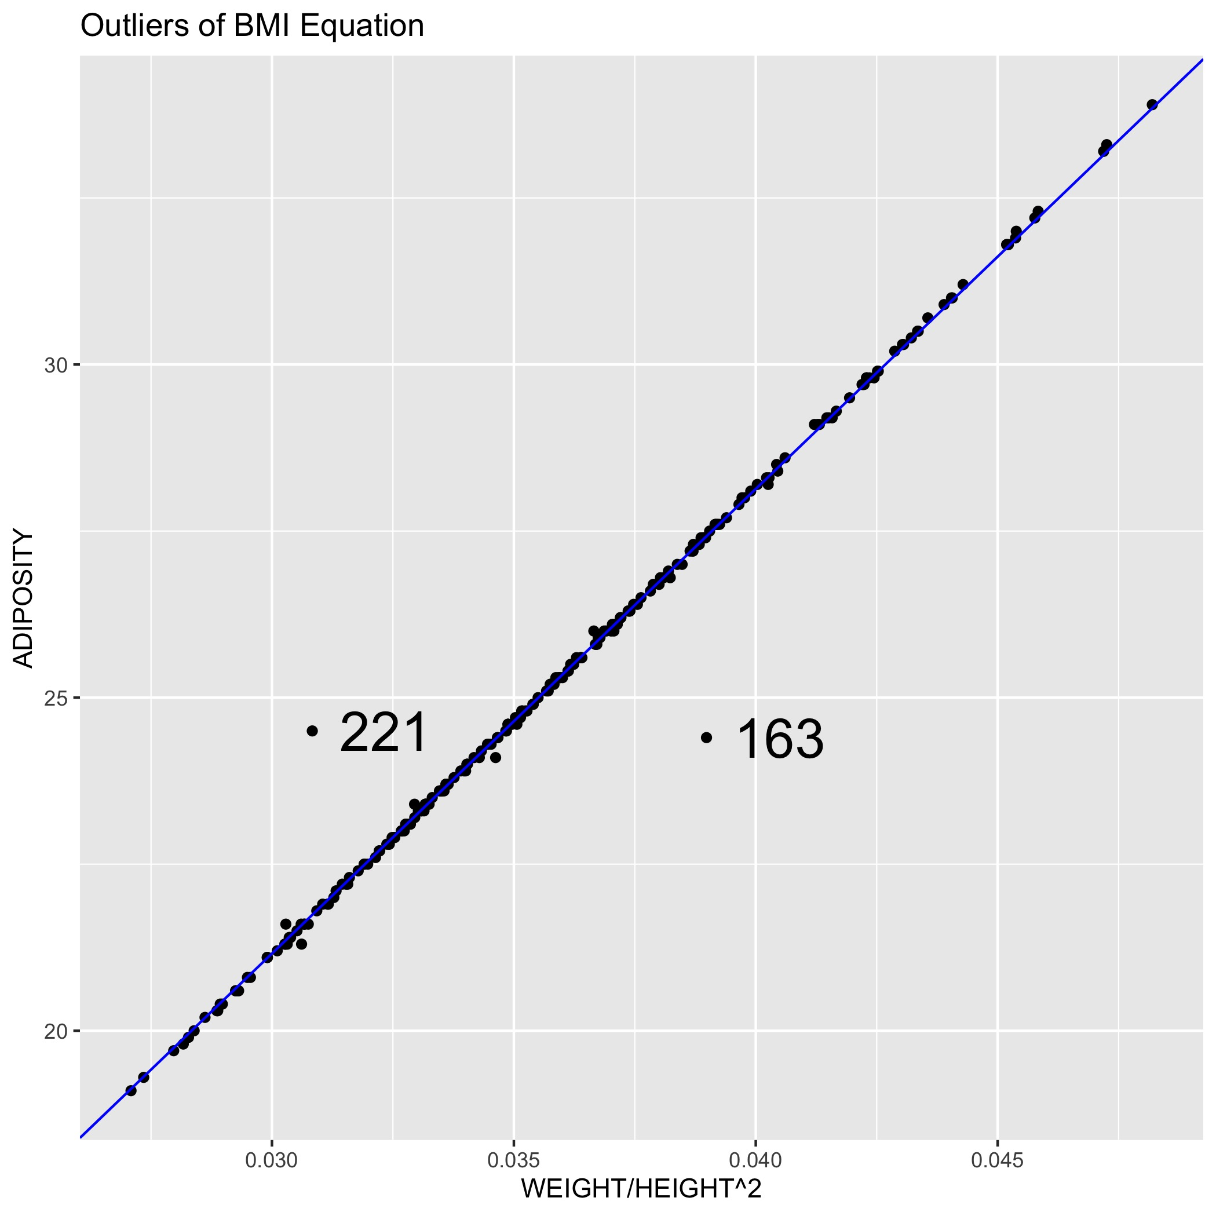

Data Clean – BMI Equation
Connection among ADIPOSITY, WEIGHT and HEIGHT in our data is called BMI equation:
BMI equation: ADIPOSITY=703 WEIGHT/HEIGHT²
Outstanding outliers in regression between ADIPOSITY and WEIGHT/HEIGHT²
You can also compare the new ADIPOSITY from BMI equation with initial one.
IDNO | Initial ADIPOSITY | New ADIPOSITY | Method
163 | 24.4 | 27.4 | Update new ADIPOSITY
221 | 24.5 | 21.7 | Update new ADIPOSITY

Slide 2
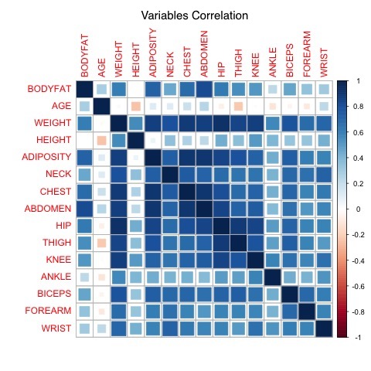
Clean Data - Summary
Table of how we deal with outliers:
It is a trade off to keep or remove outliers.
The final dataset contains 251 observations. There is high correlation among variables after clean in heat plot of correlation:
ID | Method
182 | Delete for extreme value
42 | Fix HEIGHT by BMI equation
96 | Fix DENSITY by Siri equation
76 | Fix BODYFAT by Siri equation
48 | Fix BODYFAT by Siri equation
221 | Fix ADIPOSITY by BMI equation
163 | Fix ADIPOSITY by BMI equation

Slide 3
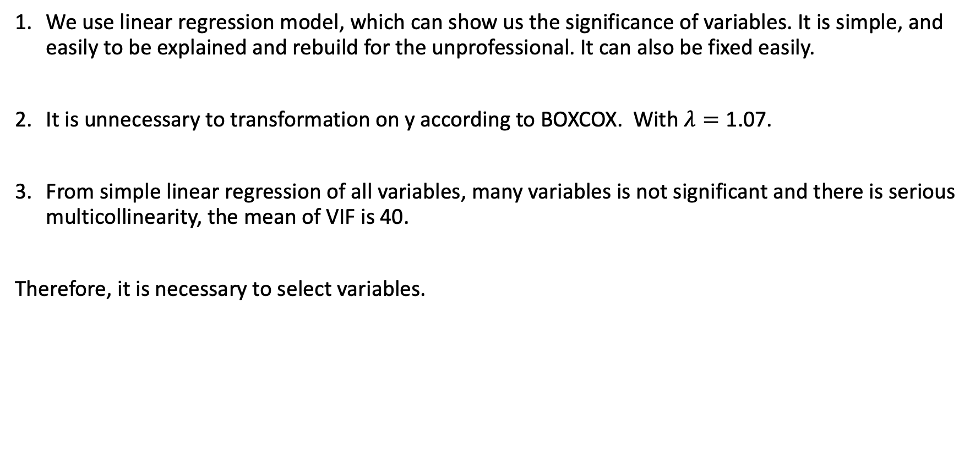
Variables Selection – Model Build
We use linear regression model, which can show us the significance of variables. It is simple, and easily to be explained and rebuild for the unprofessional. It can also be fixed easily.
It is unnecessary to transformation on y according to BOXCOX. With $λ=\text{1.0}\text{7}$.
From simple linear regression of all variables, many variables is not significant and there is serious multicollinearity, the mean of VIF is 40.
Therefore, it is necessary to select variables.

Slide 4
Variables Selection – Basic Idea
Method:
Tree regression, including bagging and boosting ones for select important variables
Subsets Method with Cp and BIC
Direction Search with AIC and BIC
We prefer both simple and precise model.
Full Model:
Four full model:
Full model with all variables: BODYFAT~AGE+WEIGHT+HEIGHT+ADIPOSITY+NECK+CHEST+ABDOMEN+HIP+THIGH+KNEE+ANKLE+BICEPS+FOREARM+WRIST
Full model with all variables after logarithmic (log()) transformation, from LogAGE to LogWRIST
Full model with all variables after square (^2) transformation, from sqAGE to sqWRIST
Full model with all variables from 1, 2, 3, with AGE, LogAGE, sqAGE and others.
We still want to figure out any improvement after transformation on x

Slide 5
Variables Selection – Subsets Method
Here we only give results of full model 4 with all variables including square and log transformation.
BODYFAT~LogABDOMEN Adjusted Rsquared = 0.6674660
BODYFAT~ABDOMEN + sqWEIGHT Adjusted Rsquared = 0.7252191
BODYFAT~sqWRIST + sqWEIGHT + ABDOMEN Adjusted Rsquared = 0.7349010
From subsets method results of four full models, the ABDOMEN and its transformation is the most important variable. WEIGHT, WRIST are also very important.

